Slide 1
Hyperscaler Agent Observability
AWS Bedrock vs Azure AI Foundry vs Google Vertex AI
Detailed Feature Comparison for Multi-Agent Systems
March 2026 • Enterprise Architecture Guide

Slide 2
Platform Overview
AWS Bedrock AgentCore
OpenTelemetry-native observability with CloudWatch integration, session/span tracing
Azure AI Foundry
Unified dashboard for multi-agent workflows with Application Insights integration
Google Vertex AI
Cloud Trace integration with DAG visualization and session-level views

Slide 3
Tracing & Instrumentation Comparison
Feature | AWS Bedrock | Azure Foundry | Vertex AI
OpenTelemetry Native | ✓ Full support | △ Partial | ✓ Full support
Auto-instrumentation | ✓ Built-in | ✓ Built-in | △ Manual setup
Session-level tracking | ✓ Yes | ✓ Yes | ✓ Yes
Span-level granularity | ✓ Yes | ✓ Yes | ✓ Yes
Custom attributes | ✓ Extensible | ✓ Extensible | △ Limited

Slide 4
Agent Workflow Observability
Feature | AWS Bedrock | Azure Foundry | Vertex AI
Multi-agent coordination view | ✓ Timeline view | ✓ Unified dashboard | ✓ DAG visualization
Agent-to-agent tracking | ✓ Full chain | ✓ Full chain | △ Basic
Tool invocation logs | ✓ Detailed | ✓ Detailed | ✓ Detailed
LLM call inspection | ✓ Prompts + tokens | ✓ Prompts + tokens | ✓ Prompts + tokens
Memory state tracking | ✓ Read/write logs | △ Limited | ✗ Not native

Slide 5
Metrics & Performance Monitoring
Feature | AWS Bedrock | Azure Foundry | Vertex AI
Latency metrics | ✓ P50/P95/P99 | ✓ P50/P95/P99 | ✓ P50/P95/P99
Token usage tracking | ✓ Per-agent | ✓ Per-agent | ✓ Per-agent
Cost attribution | ✓ Real-time | ✓ Real-time | △ Delayed
Error rate monitoring | ✓ CloudWatch | ✓ App Insights | ✓ Cloud Monitoring
Custom dashboards | ✓ Grafana/QuickSight | ✓ Power BI | ✓ Looker/Data Studio

Slide 6
Debugging & Incident Response
Feature | AWS Bedrock | Azure Foundry | Vertex AI
Trace replay capability | ✓ Full replay | ✓ Full replay | △ Read-only
Root cause analysis | ✓ Automated suggestions | ✓ AI-assisted | △ Manual
Anomaly detection | ✓ ML-powered | ✓ ML-powered | ✓ ML-powered
Alert configuration | ✓ Multi-channel | ✓ Multi-channel | ✓ Multi-channel
Incident timeline view | ✓ Detailed | ✓ Detailed | △ Basic

Slide 7
Evaluation & Quality Monitoring
Feature | AWS Bedrock | Azure Foundry | Vertex AI
Automated evaluations | ✓ Built-in | ✓ Extensive | △ Basic
Custom evaluators | ✓ Supported | ✓ Supported | ✓ Supported
Regression detection | △ Manual setup | ✓ Automated | ✗ Not native
A/B testing support | ✓ Yes | ✓ Yes | △ Limited
Quality score tracking | ✓ Continuous | ✓ Continuous | △ Periodic

Slide 8
Compliance & Governance
Feature | AWS Bedrock | Azure Foundry | Vertex AI
Audit trail immutability | ✓ Immutable logs | ✓ Immutable logs | ✓ Immutable logs
Data lineage tracking | ✓ Full lineage | ✓ Full lineage | △ Partial
PII detection | ✓ Automated | ✓ Automated | △ Manual tags
Compliance reporting | ✓ Pre-built templates | ✓ Pre-built templates | △ Custom only
Policy enforcement | ✓ Real-time gates | ✓ Real-time gates | △ Post-hoc

Slide 9
Integration & Extensibility
Feature | AWS Bedrock | Azure Foundry | Vertex AI
Third-party tools | ✓ Datadog, Dynatrace | ✓ AppDynamics | △ Limited
SIEM integration | ✓ CloudTrail + SIEM | ✓ Sentinel native | ✓ Chronicle native
Custom exporters | ✓ S3, Kinesis | ✓ Event Hubs, Blob | ✓ BigQuery, Pub/Sub
API for telemetry | ✓ Full REST API | ✓ Full REST API | ✓ Full REST API
Webhook notifications | ✓ SNS/Lambda | ✓ Logic Apps | ✓ Cloud Functions

Slide 10
Cost & Retention
Feature | AWS Bedrock | Azure Foundry | Vertex AI
Pricing model | Per trace + storage | Per GB ingested | Per span + storage
Free tier | ✓ 10k traces/month | ✓ 5 GB/month | ✓ 2.5M spans/month
Default retention | 15 days (configurable) | 90 days (configurable) | 30 days (configurable)
Long-term archival | ✓ S3 Glacier | ✓ Archive Storage | ✓ Coldline Storage
Sampling controls | ✓ Intelligent sampling | ✓ Intelligent sampling | ✓ Intelligent sampling

Slide 11
AWS Bedrock AgentCore: Strengths
✓ Best OpenTelemetry integration with minimal setup
✓ Memory state tracking built-in for stateful agents
✓ Seamless CloudWatch integration for existing AWS users
✓ Strong third-party observability platform support

Slide 12
Azure AI Foundry: Strengths
✓ Most comprehensive unified dashboard for multi-agent views
✓ Best automated evaluation and regression detection
✓ AI-assisted root cause analysis built-in
✓ Longest default retention period (90 days)

Slide 13
Google Vertex AI Agent Builder: Strengths
✓ Excellent DAG visualization for complex workflows
✓ Native BigQuery integration for analytics at scale
✓ Strong Chronicle SIEM integration for security teams
✓ Generous free tier (2.5M spans/month)

Slide 14
Decision Framework: When to Choose AWS
Already using AWS ecosystem (Lambda, Step Functions, DynamoDB)
Need best-in-class OpenTelemetry support
Stateful agents requiring memory state tracking
Using Datadog or Dynatrace for enterprise observability

Slide 15
Decision Framework: When to Choose Azure
Complex multi-agent workflows requiring unified visibility
Need continuous automated evaluation and quality regression detection
Enterprise compliance with extensive audit requirements
Already using Azure Sentinel for security operations

Slide 16
Decision Framework: When to Choose Google
Need large-scale analytics on agent traces via BigQuery
Workflow visualization is critical for stakeholder communication
Security team already using Chronicle SIEM
Cost-sensitive deployments leveraging generous free tier

Slide 17
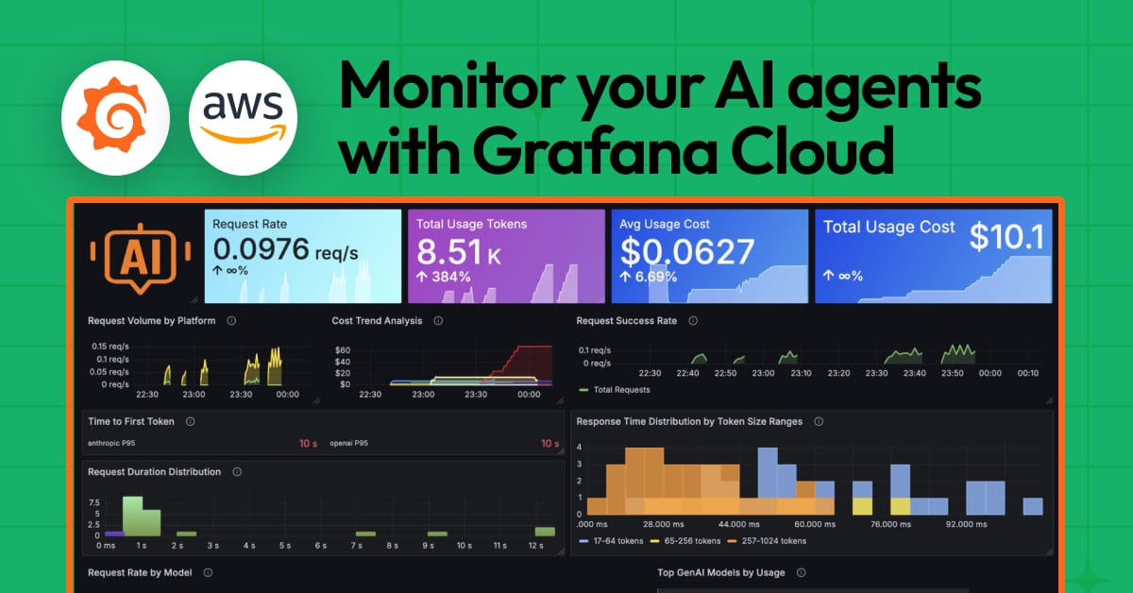
AWS Bedrock Dashboard Example
Real-time metrics, latency, cost tracking with CloudWatch integration

Slide 18
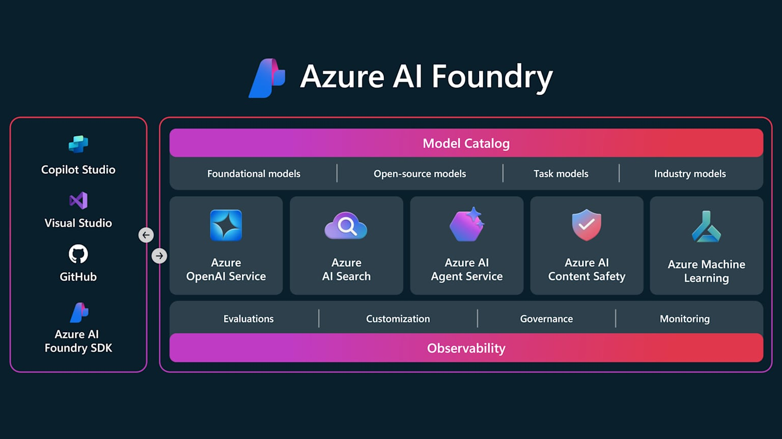
Azure AI Foundry Dashboard Example
Unified view across models, evaluation, observability, and governance

Slide 19
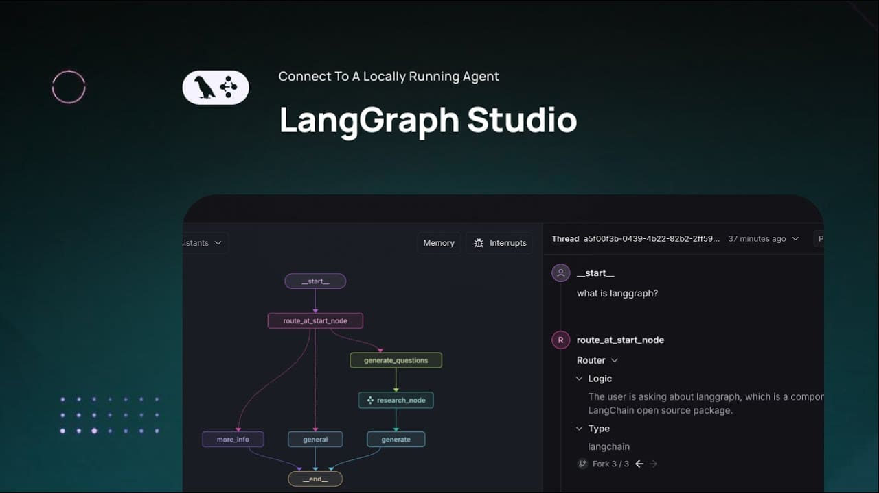
LangSmith Multi-Agent Tracing
Platform-agnostic option: LangSmith for LangGraph-based multi-agent systems

Slide 20
Platform-Agnostic Alternatives
LangSmith: Best for LangChain/LangGraph workflows, deep framework integration
Langfuse: Open-source, self-hostable, framework-agnostic tracing
Datadog LLM Observability: Enterprise-grade with APM integration
Maxim AI: Continuous improvement focused, A/B testing native

Slide 21
Key Takeaways: Hyperscaler Comparison
All three platforms provide enterprise-grade observability
AWS wins on OpenTelemetry integration and memory tracking
Azure excels at unified dashboards and automated quality monitoring
Google leads in analytics at scale and DAG visualization

Slide 22
Key Resources & Documentation
AWS Bedrock AgentCore: docs.aws.amazon.com/bedrock-agentcore/latest/devguide/observability.html
Azure AI Foundry Agents: learn.microsoft.com/en-us/azure/azure-monitor/app/agents-view
Vertex AI Agent Builder: cloud.google.com/agent-builder/agent-engine/manage/tracing
Comparison Guide: getmaxim.ai/articles/top-5-ai-agent-monitoring-platforms-in-2025

Slide 23
Thank You!
Questions?
Choose the platform that matches your ecosystem. All support production-grade multi-agent observability.

